Slide 1
Resume Writing Tips

Slide 2
First Resume
First Resume

Slide 3
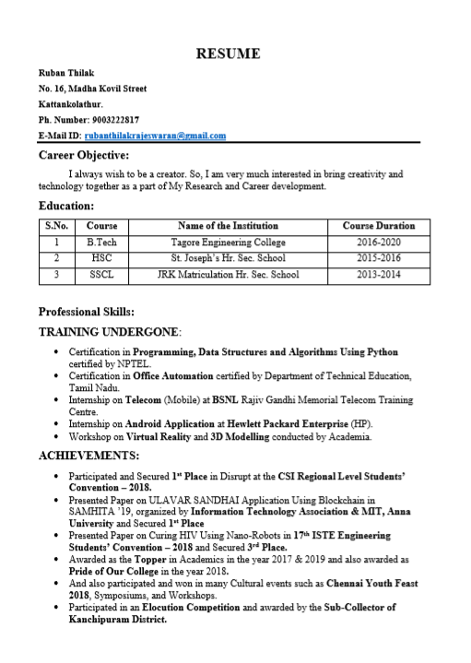

Slide 4
Single Page
De-clutter
Clarity
Design
Validation
Words
Delight the Person
Being Humble

Slide 5
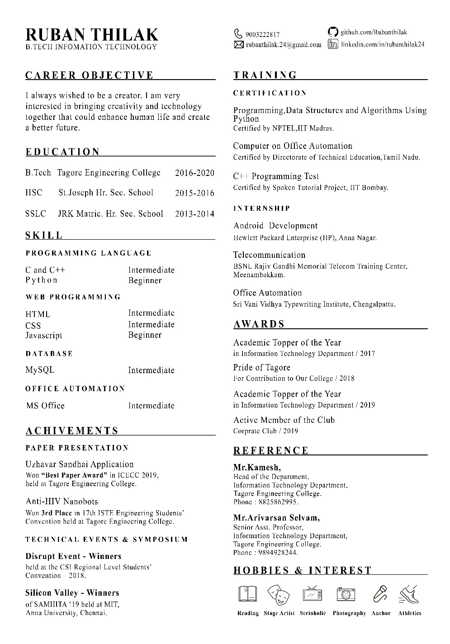

Slide 6
Design
Single Page
De-clutter
Clarity
Words
Delight the Person
Being Humble
Validation

Slide 7
First Resume
De-clutter-ness…

Slide 8
Key Elements
About Me
Education
Training
Achievement
Award
Skill

Slide 9
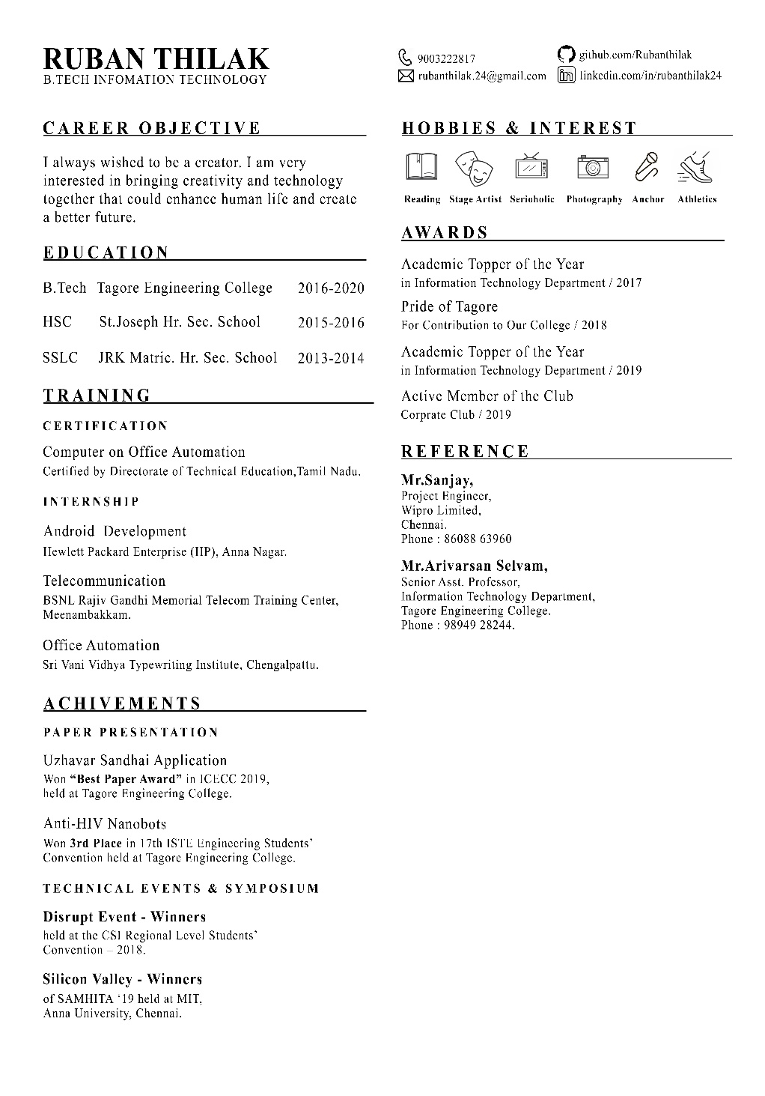

Slide 10
Design
Single Page
De-clutter
Clarity
Words
Delight the Person
Being Humble
Validation

Slide 11
First Resume
Name & Stream
Phone Number
E-Mail
About Me
GitHub
LinkedIn
Website

Slide 12
First Resume
RUBAN THILAK
B.TECH INFORMATION TECHNOLOGY
9874563210 rubanthilak@zoho github.com/ruban linkedin.com/ruban

Slide 13
First Resume
Career Objective

Slide 14
First Resume
Education

Slide 15
Education
Bachelor of Technology
Tagore Engineering College
2016 – 2020

Slide 16
First Resume
No Percentage %

Slide 17
First Resume
Training

Slide 18
Intership
Certification

Slide 19
Intership
Android Development
KaaShiv InfoTech
Anna Nagar

Slide 20
Certification
C++ Certification
Certified by HP Inc.
Anna Nagar

Slide 21
First Resume
Achievements

Slide 22
Paper Presentation
Technical Events

Slide 23
Paper Presentation
Smart Switch IOT
Won “BEST PAPER AWARD” in ISTE Convention 2019
Tagore Engineering College

Slide 24
Technical Events
Codex - Winners
ISTE Convention 2019
MIT, Anna University

Slide 25
First Resume
Awards

Slide 26
Skills
Beginner
Intermediate
Expert

Slide 27
First Resume
Hobbies & Interest

Slide 28
Design
Single Page
De-clutter
Clarity
Words
Delight the Person
Being Humble
Validation

Slide 29
Words
Data Structure, Algorithm and Programming Using Python
Python Certification

Slide 30
Design
Single Page
De-clutter
Clarity
Words
Delight the Person
Being Humble
Validation

Slide 31
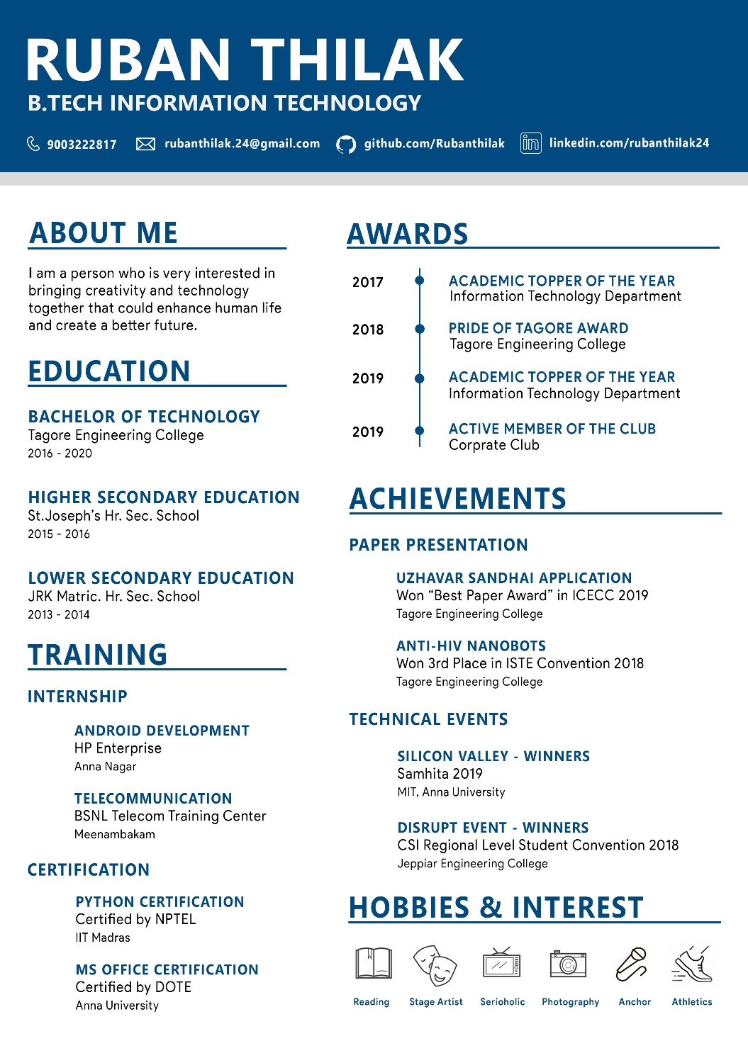

Slide 32
First Resume
Thank You

